Slide 1
The Scientific Method
Observations
Questions
Hypotheses
Predictions
Tests
Outcomes

Slide 2
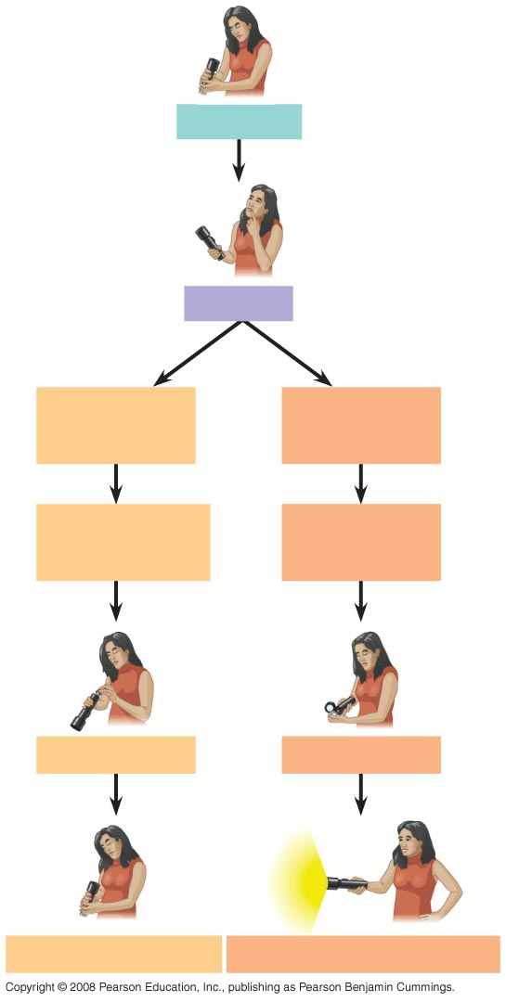
Observations
Question
Hypothesis #1:
Dead batteries
Hypothesis #2:
Burnt-out bulb
Prediction:
Replacing batteries
will fix problem
Prediction:
Replacing bulb
will fix problem
Test prediction
Test prediction
Test falsifies hypothesis
Test does not falsify hypothesis

Slide 3
Fundamental Quantities
Distance
Time
Mass
Temperature
Amount of substance

Slide 4
Metric Prefixes
Giga- one billion (1,000,000,000 = 10⁹) G
Mega- one million (1,000,000 = 10⁶) M
Kilo- one thousand (1,000 = 10³) k
Hecto- one hundred (100 = 10²) h
Deca- ten (10 = 10¹) da
(no prefix) one (1 = 10⁰)
Deci- one-tenth (0.1 = 10⁻¹) d
Centi- one-hundredth (0.01 = 10⁻²) c
Milli- one-thousandth (0.001 = 10⁻³) m
Micro- one-millionth (0.000001 = 10⁻⁶) μ
Nano- one-billionth (0.000000001 = 10⁻⁹) n

Slide 5
How many millimeters are in 150 miles?
Use dimensional analysis to find out.
These are conversion factors.
All units cancel except the ones that should be in the answer.
This is given in the problem.
To three significant figures, the answer is 241 million millimeters,
or 2.41 x 10⁸ mm.

Slide 6
Metric System Nations

