Slide 1
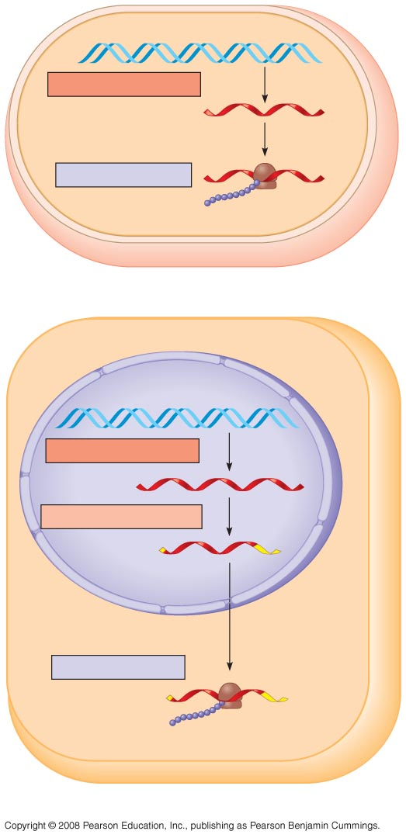
TRANSCRIPTION
DNA
mRNA
Ribosome
TRANSLATION
Polypeptide
(a) Bacterial cell
Nuclear
envelope
TRANSCRIPTION
DNA
RNA PROCESSING
Pre-mRNA
mRNA
TRANSLATION
Ribosome
Polypeptide
(b) Eukaryotic cell

Slide 2
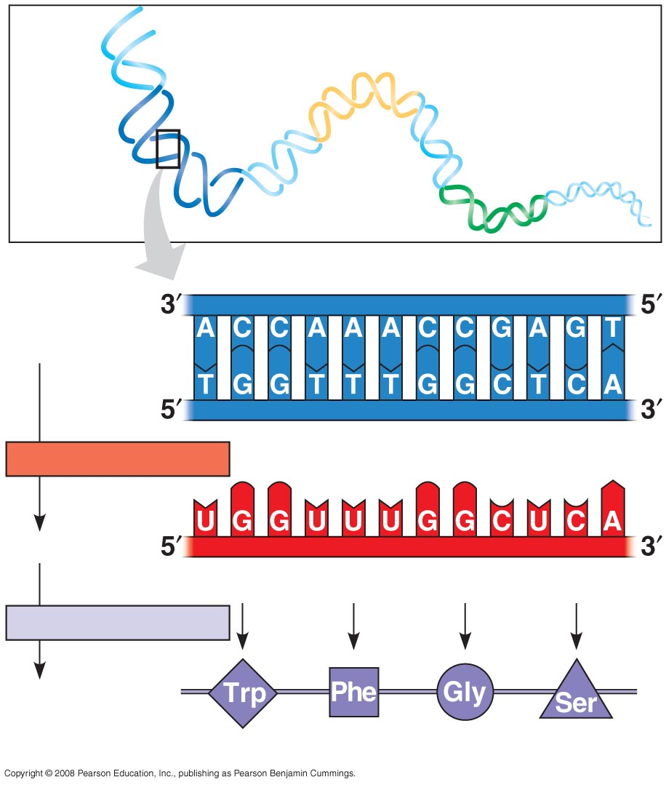
Gene 2
DNA
molecule
Gene 1
Gene 3
DNA
template
strand
TRANSCRIPTION
mRNA
Codon
TRANSLATION
Protein
Amino acid

Slide 3
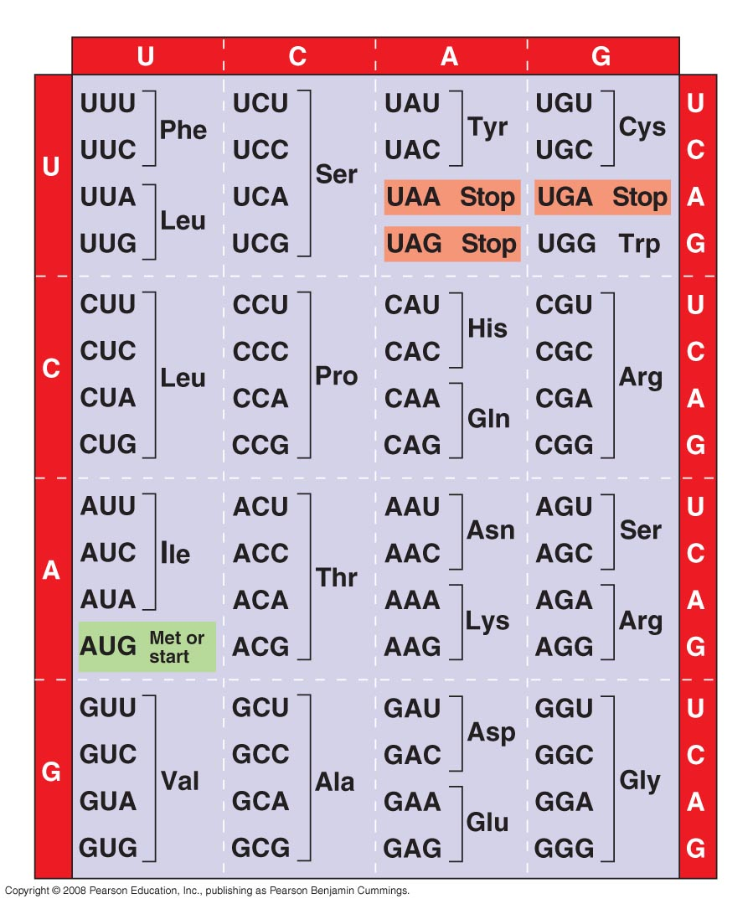
Second mRNA base
First mRNA base (5′ end of codon)
Third mRNA base (3′ end of codon)

Slide 4
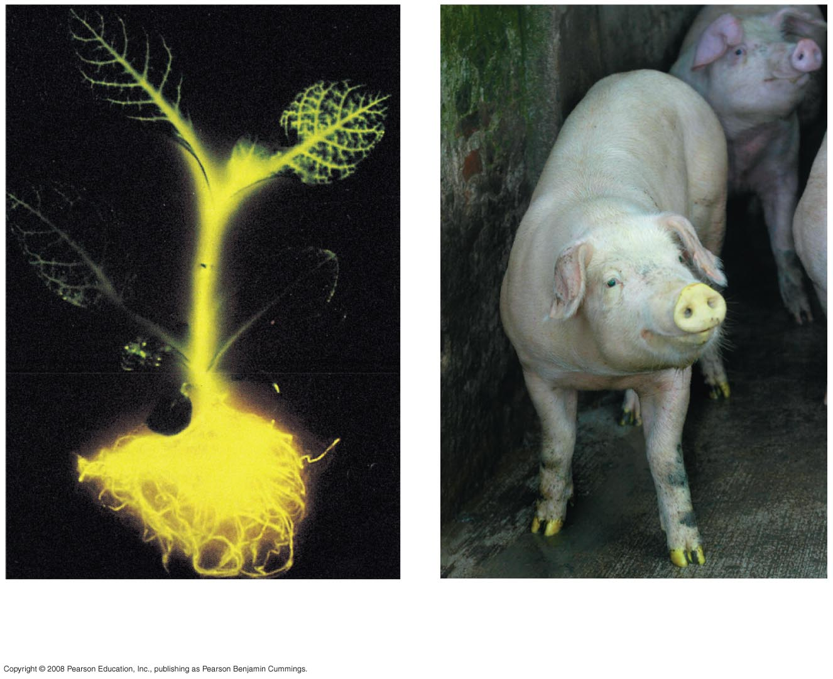
(a) Tobacco plant expressing
a firefly gene
(b) Pig expressing a
jellyfish gene

Slide 5
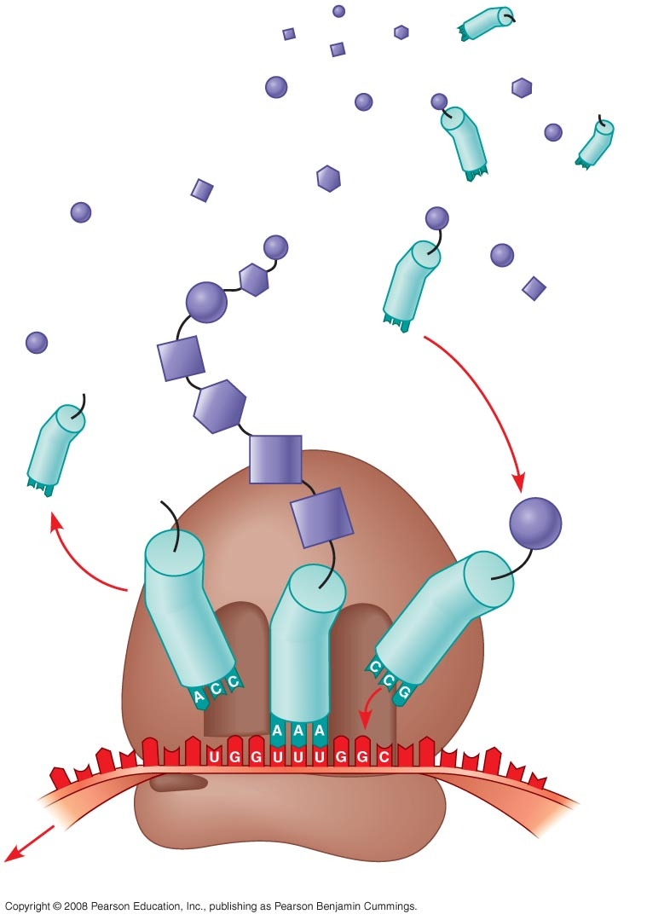
Amino
acids
Polypeptide
tRNA with
amino acid
attached
Ribosome
Trp
Phe
Gly
tRNA
Anticodon
5′
Codons
3′
mRNA

Slide 6
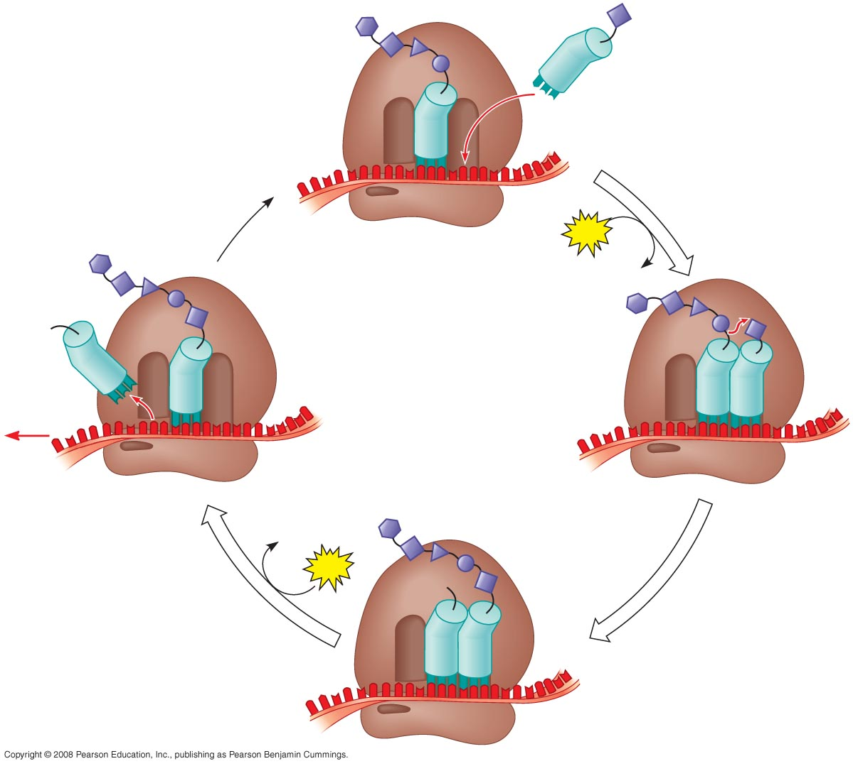
Amino end
of polypeptide
E
3′
mRNA
Ribosome ready for
next aminoacyl tRNA
5′
P
site
A
site
GTP
GDP
E
E
P
A
P
A
GDP
GTP
E
P
A

Slide 7
Release
factor
Free
polypeptide
5′
3′
3′
3′
5′
5′
2
GTP
Stop codon
(UAG, UAA, or UGA)
2 GDP

Slide 8
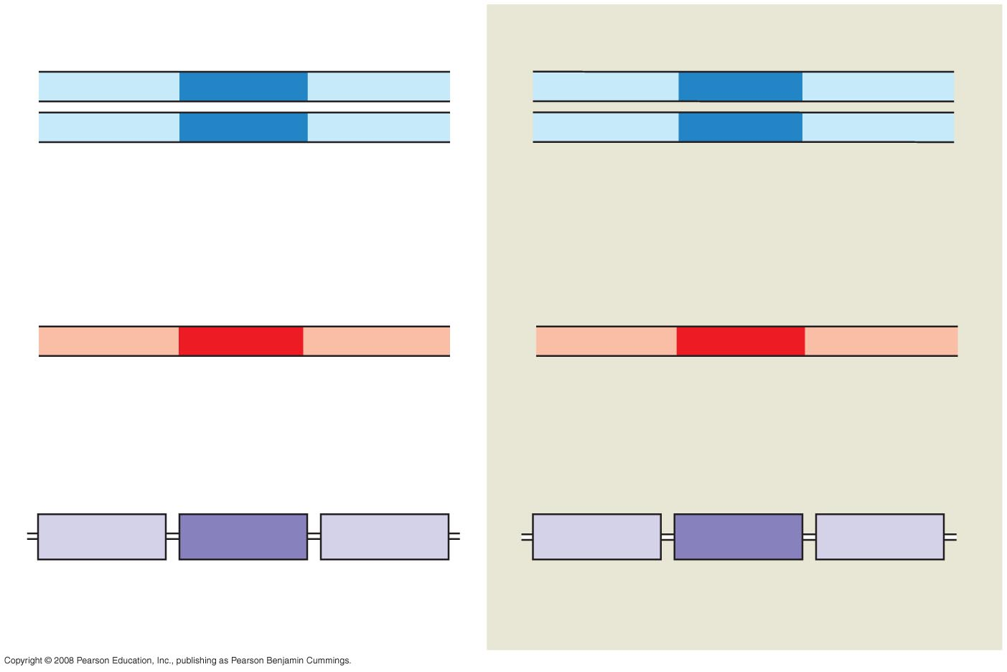
Wild-type hemoglobin DNA
Mutant hemoglobin DNA
3′
C
T
T
5′
3′
C
A
T
5′
5′
G
A
A
3′
5′
G
T
A
3′
mRNA
mRNA
5′
G
A
A
3′
5′
G
U
A
3′
Normal hemoglobin
Sickle-cell hemoglobin
Glu
Val

