Slide 1
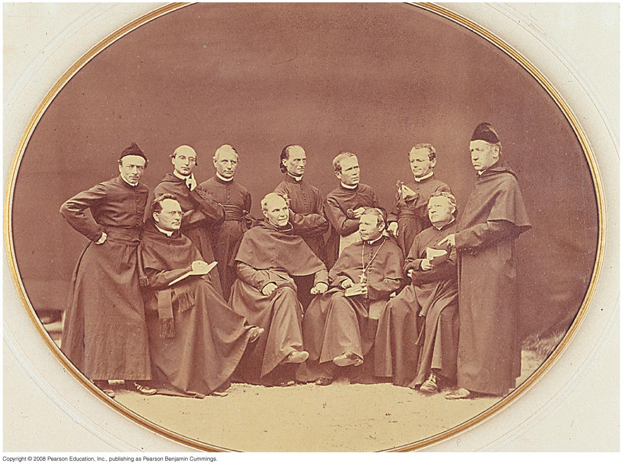
Gregor Mendel
1822 – 1884 C.E.

Slide 2
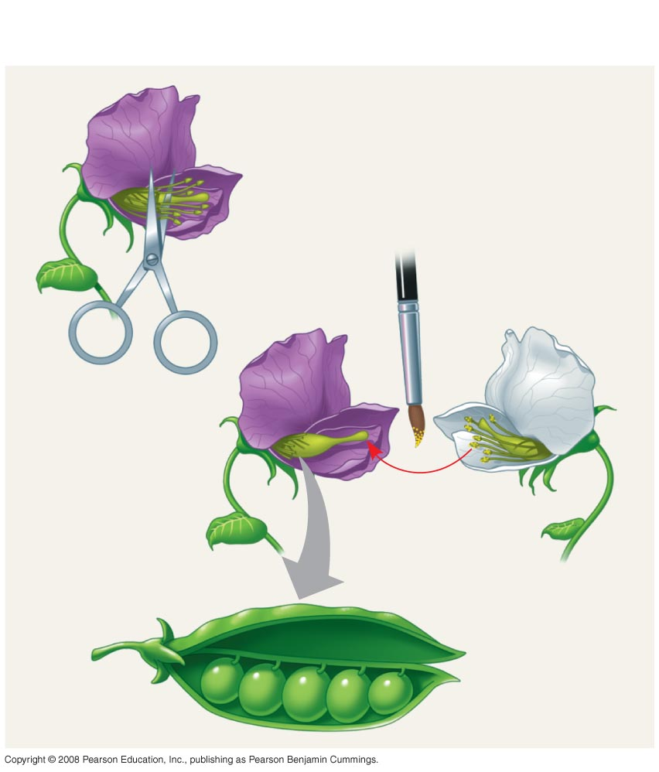
TECHNIQUE
1
2
Parental
generation
(P)
Stamens
Carpel
3
4

Slide 3
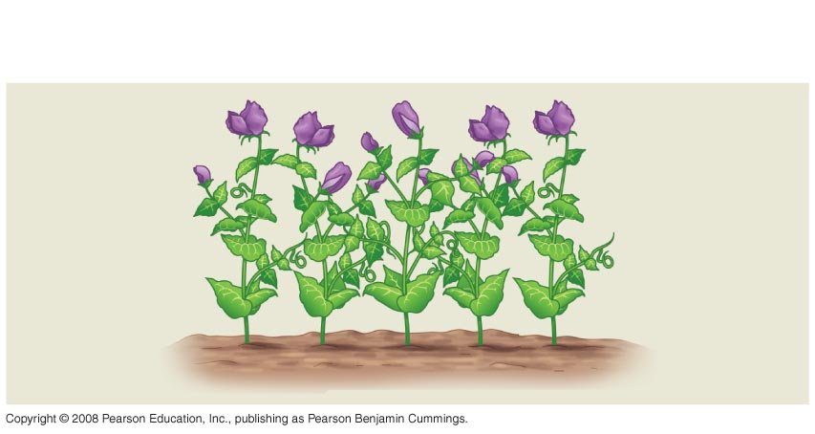
RESULTS
First
filial
gener-
ation
offspring
(F₁)
5

Slide 4
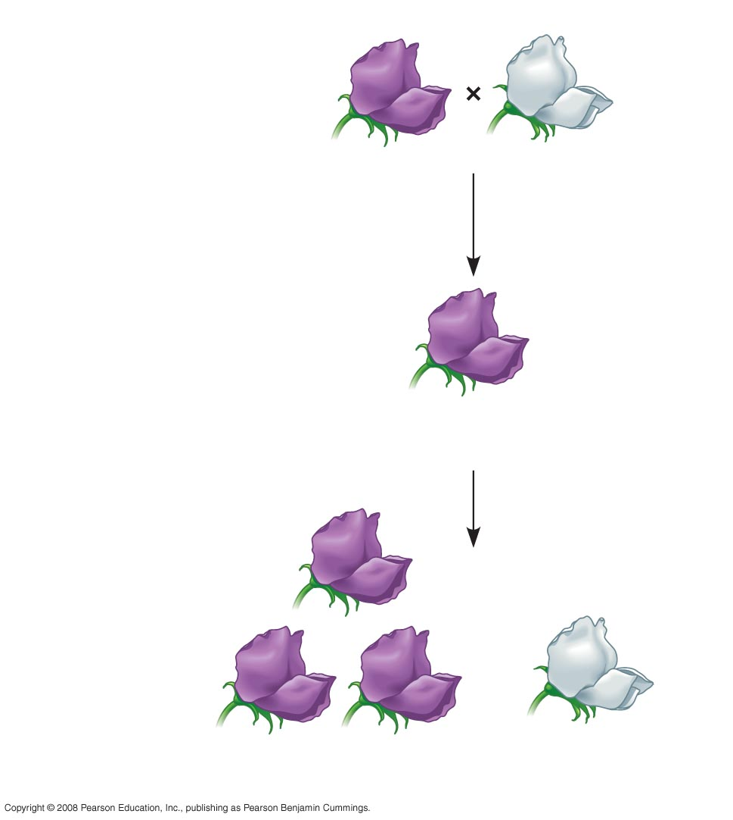
EXPERIMENT
P Generation
(true-breeding
parents)
×
Purple
flowers
White
flowers
F₁ Generation
(hybrids)
All plants had
purple flowers
F₂ Generation
705 purple-flowered
plants
224 white-flowered
plants

Slide 5
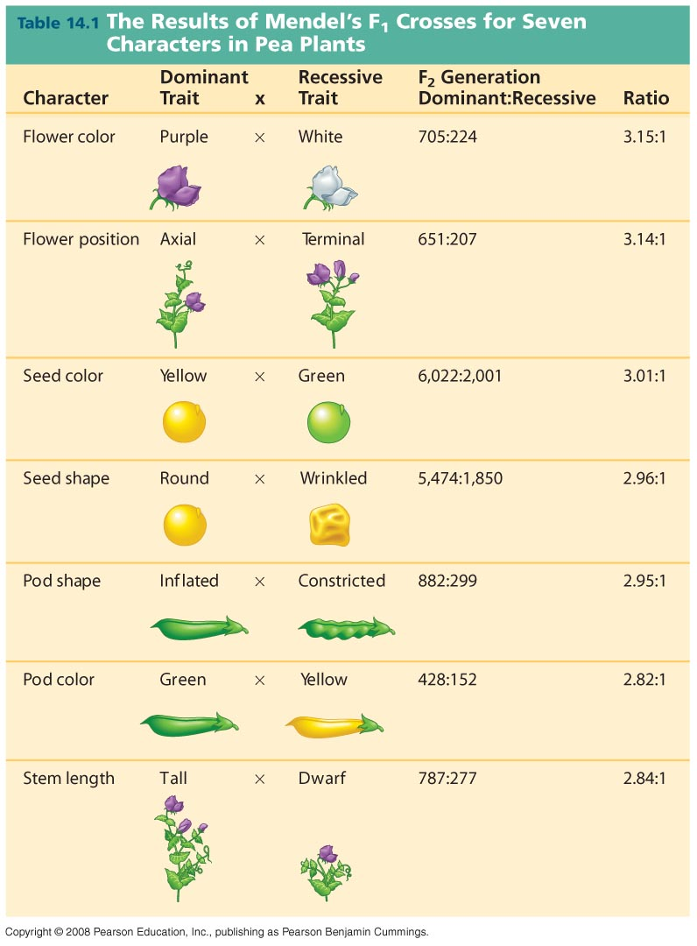

Slide 6
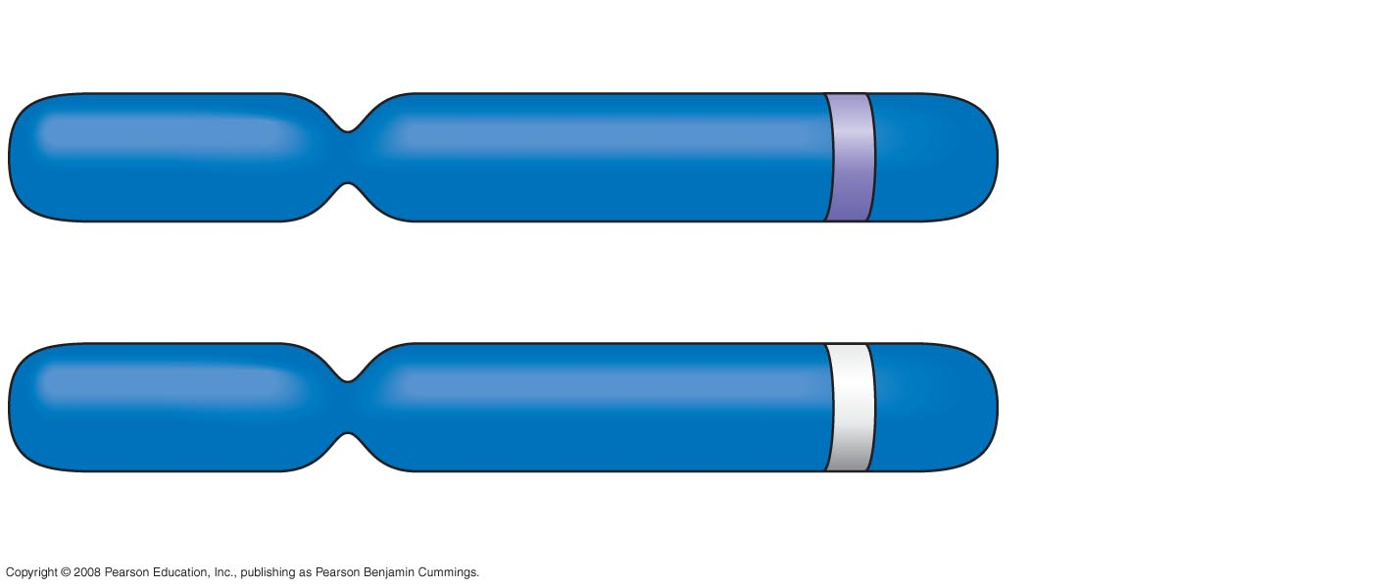
Allele for purple flowers
Homologous
pair of
chromosomes
Locus for flower-color gene
Allele for white flowers

Slide 7
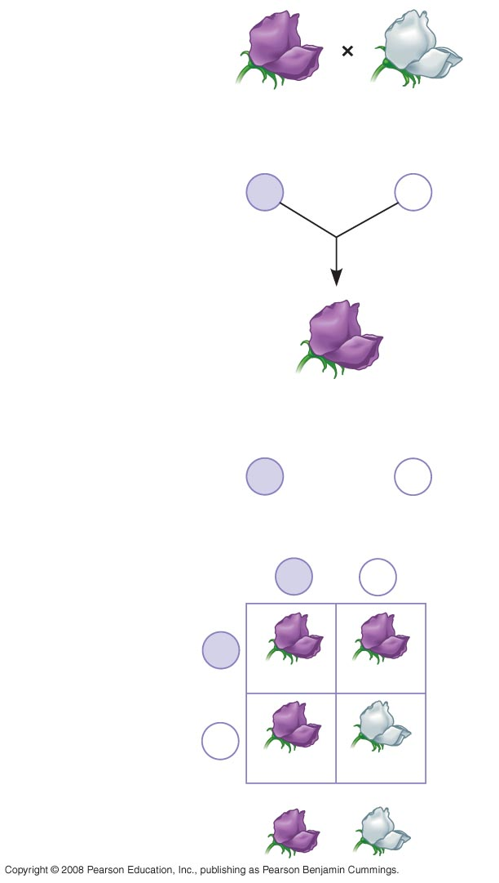
P Generation
Appearance:
Purple flowers
White flowers
Genetic makeup:
PP
pp
Gametes:
P
p
F₁ Generation
Appearance:
Purple flowers
Genetic makeup:
Pp
Gametes:
¹/₂
P
¹/₂
p
Sperm
F₂ Generation
P
p
P
Eggs
PP
Pp
p
Pp
pp
3
1

Slide 8
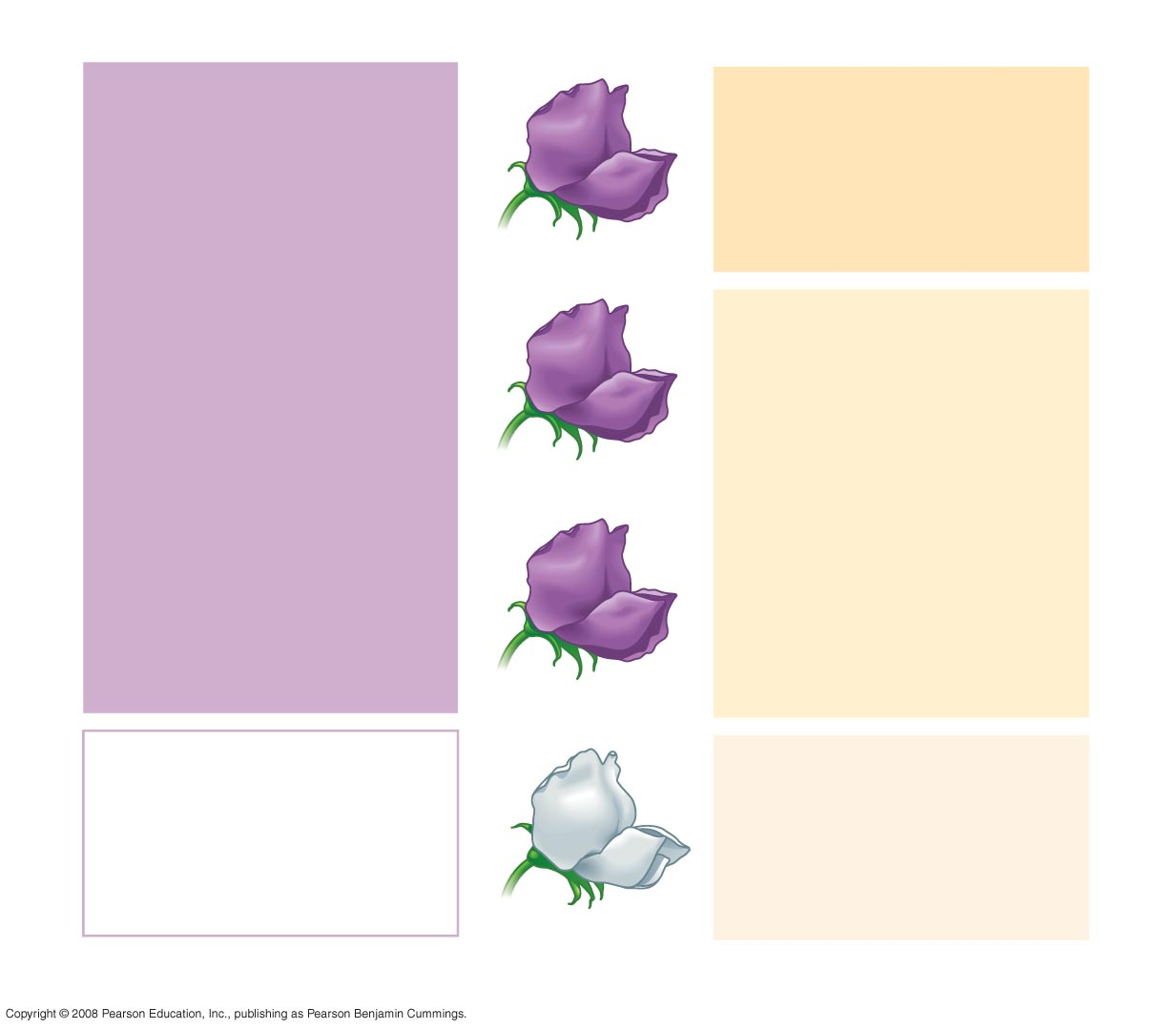
Phenotype
Genotype
Purple
PP
1
(homozygous)
3
Purple
Pp
(heterozygous)
2
Purple
Pp
(heterozygous)
White
pp
1
(homozygous)
1
Ratio 3:1
Ratio 1:2:1

Slide 9
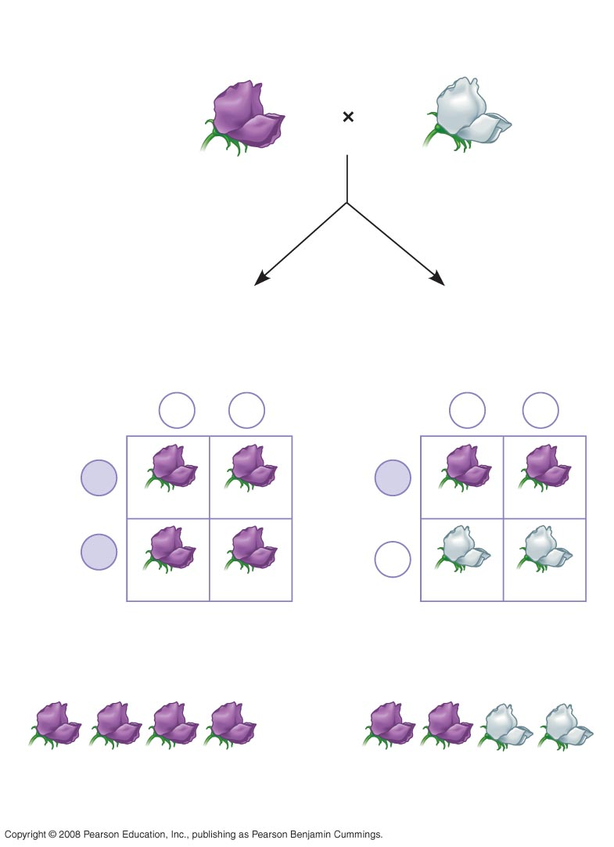
TECHNIQUE
×
Dominant phenotype,
unknown genotype:
PP or Pp?
Recessive phenotype,
known genotype:
pp
Predictions
If PP
or
If Pp
Sperm
Sperm
p
p
p
p
P
P
Eggs
Pp
Pp
Eggs
Pp
Pp
P
p
Pp
Pp
pp
pp
RESULTS
or
All offspring purple
¹/₂ offspring purple and
¹/₂ offspring white

Slide 10
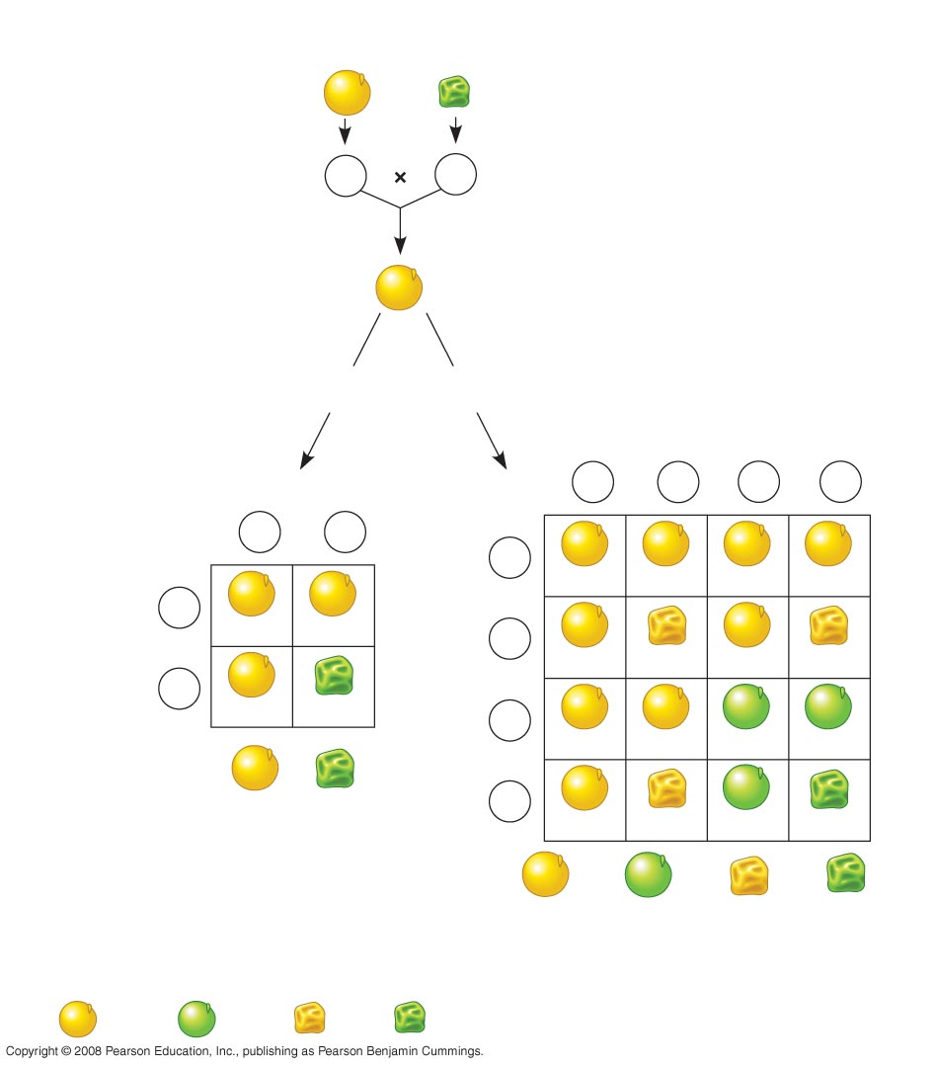
EXPERIMENT
P Generation
YYRR
yyrr
Gametes
YR
×
yr
F₁ Generation
YyRr
Hypothesis of
dependent
assortment
Hypothesis of
independent
assortment
Predictions
Predicted
offspring of
F₂ generation
or
Sperm
Sperm
¹/₄
YR
¹/₄
Yr
¹/₄
yR
¹/₄
yr
¹/₂
YR
¹/₂
yr
¹/₄
YR
YYRR
YYRr
YyRR
YyRr
¹/₂
YR
Eggs
YYRR
YyRr
¹/₄
Yr
Eggs
YYRr
YYrr
YyRr
Yyrr
¹/₂
yr
YyRr
yyrr
¹/₄
yR
YyRR
YyRr
yyRR
yyRr
³/₄
¹/₄
Phenotypic ratio 3:1
¹/₄
yr
YyRr
Yyrr
yyRr
yyrr
⁹/₁₆
³/₁₆
³/₁₆
¹/₁₆
Phenotypic ratio 9:3:3:1
RESULTS
315
108
101
32
Phenotypic ratio approximately 9:3:3:1

Slide 11
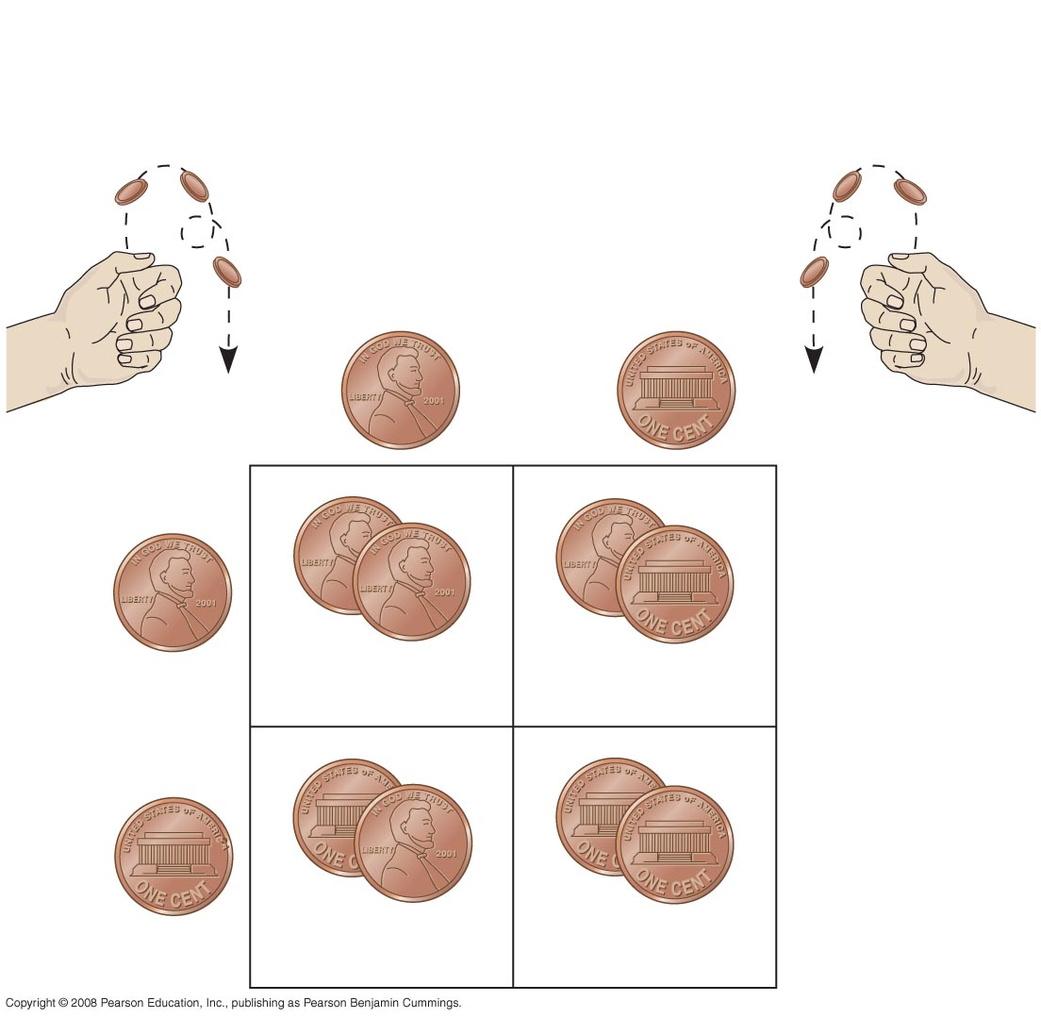
Rr
×
Rr
Segregation of
alleles into eggs
Segregation of
alleles into sperm
Sperm
¹/₂
R
¹/₂
r
R
R
¹/₂
R
R
r
¹/₄
¹/₄
Eggs
r
r
¹/₂
r
R
r
¹/₄
¹/₄

Slide 12
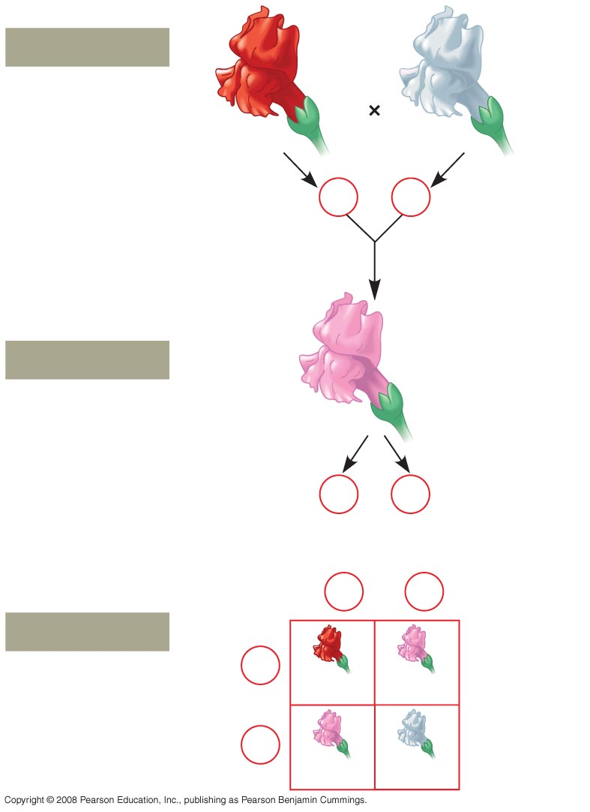
P Generation
Red
White
C^{R}C^{R}
C^{W}C^{W}
Gametes
C^{R}
C^{W}
F₁ Generation
Pink
C^{R}C^{W}
Gametes
¹/₂
C^{R}
¹/₂
C^{W}
Sperm
¹/₂
C^{R}
¹/₂
C^{W}
F₂ Generation
¹/₂
C^{R}
Eggs
C^{R}C^{R}
C^{R}C^{W}
¹/₂
C^{W}
C^{R}C^{W}
C^{W}C^{W}

Slide 13
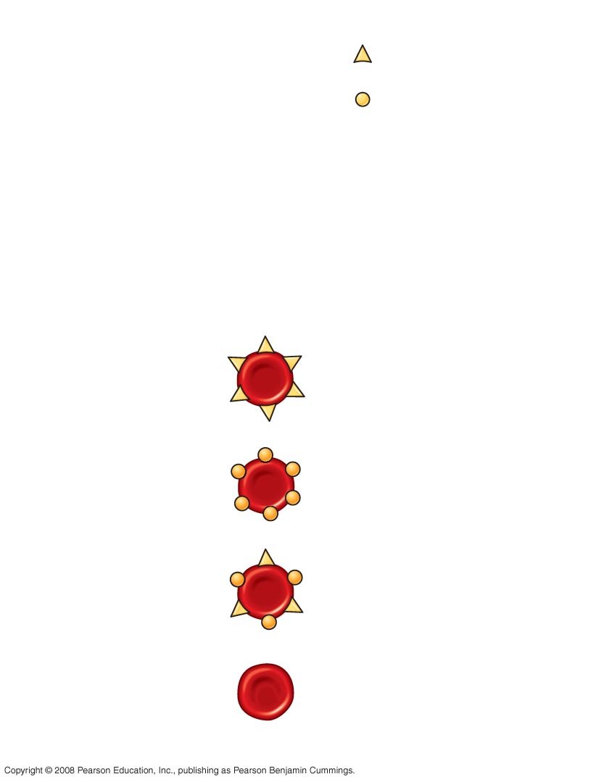
Allele
Carbohydrate
I^{A}
A
I^{B}
B
i
none
(a) The three alleles for the ABO blood groups
and their associated carbohydrates
Red blood cell
appearance
Phenotype
(blood group)
Genotype
I^{A}I^{A} or I^{A} i
A
I^{B}I^{B} or I^{B} i
B
I^{A}I^{B}
AB
ii
O
(b) Blood group genotypes and phenotypes

Slide 14
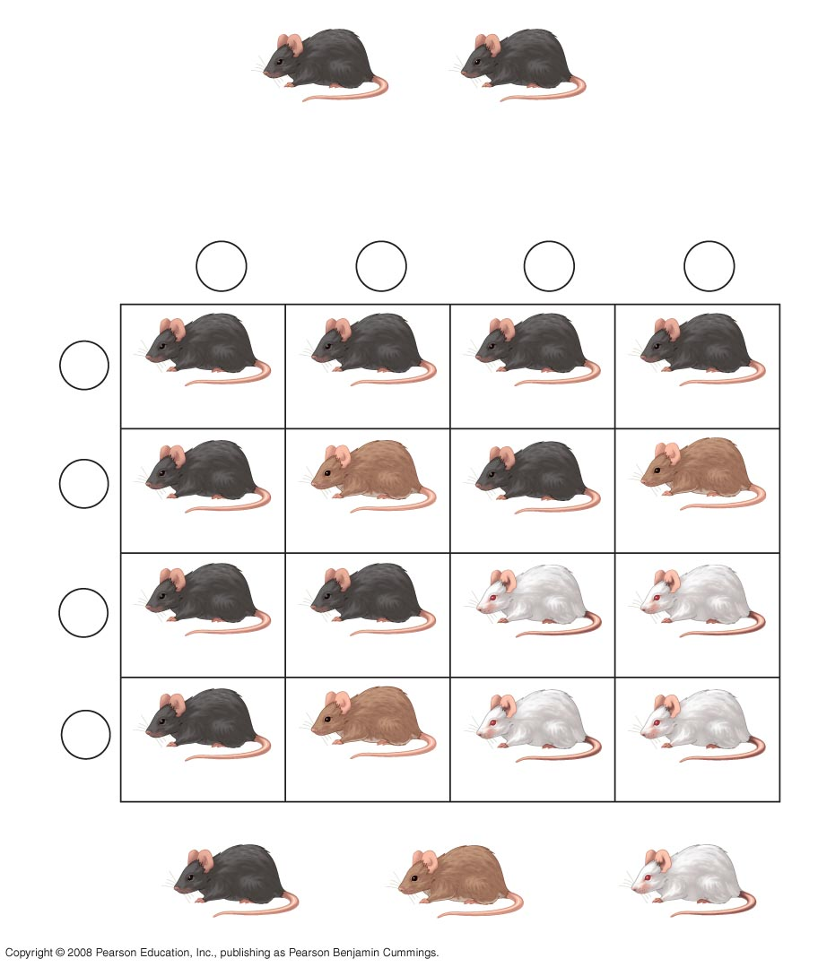
×
BbCc
BbCc
Sperm
¹/₄
BC
¹/₄
bC
¹/₄
Bc
¹/₄
bc
Eggs
¹/₄
BC
BBCC
BbCC
BBCc
BbCc
¹/₄
bC
BbCC
bbCC
BbCc
bbCc
¹/₄
Bc
BBCc
BbCc
BBcc
Bbcc
¹/₄
bc
BbCc
bbCc
Bbcc
bbcc
9
: 3
: 4

Slide 15
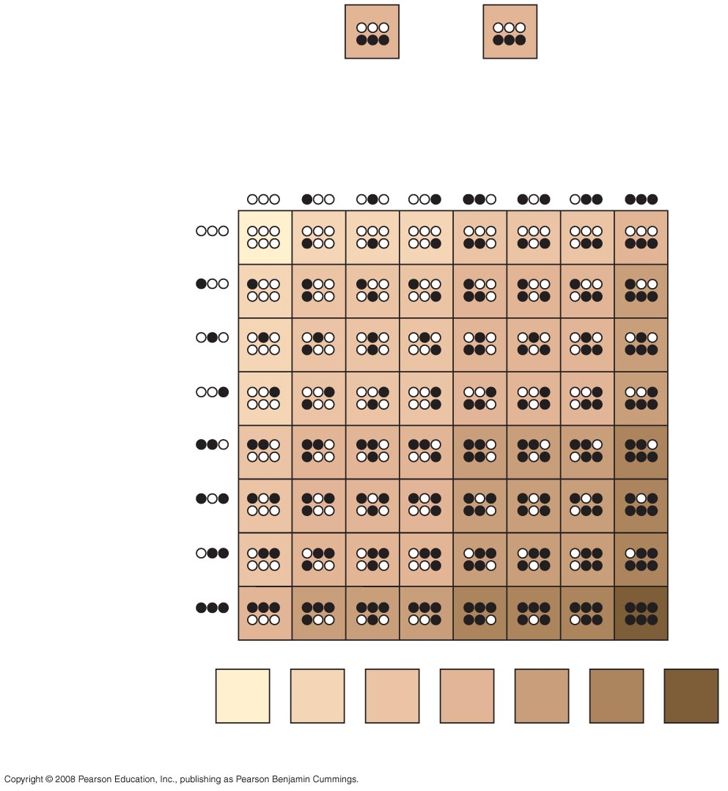
×
AaBbCc
AaBbCc
Sperm
¹/₈
¹/₈
¹/₈
¹/₈
¹/₈
¹/₈
¹/₈
¹/₈
¹/₈
¹/₈
¹/₈
¹/₈
Eggs
¹/₈
¹/₈
¹/₈
¹/₈
Phenotypes:
¹/₆₄
⁶/₆₄
¹⁵/₆₄
²⁰/₆₄
¹⁵/₆₄
⁶/₆₄
¹/₆₄
Number of
dark-skin alleles:
0
1
2
3
4
5
6

Slide 16
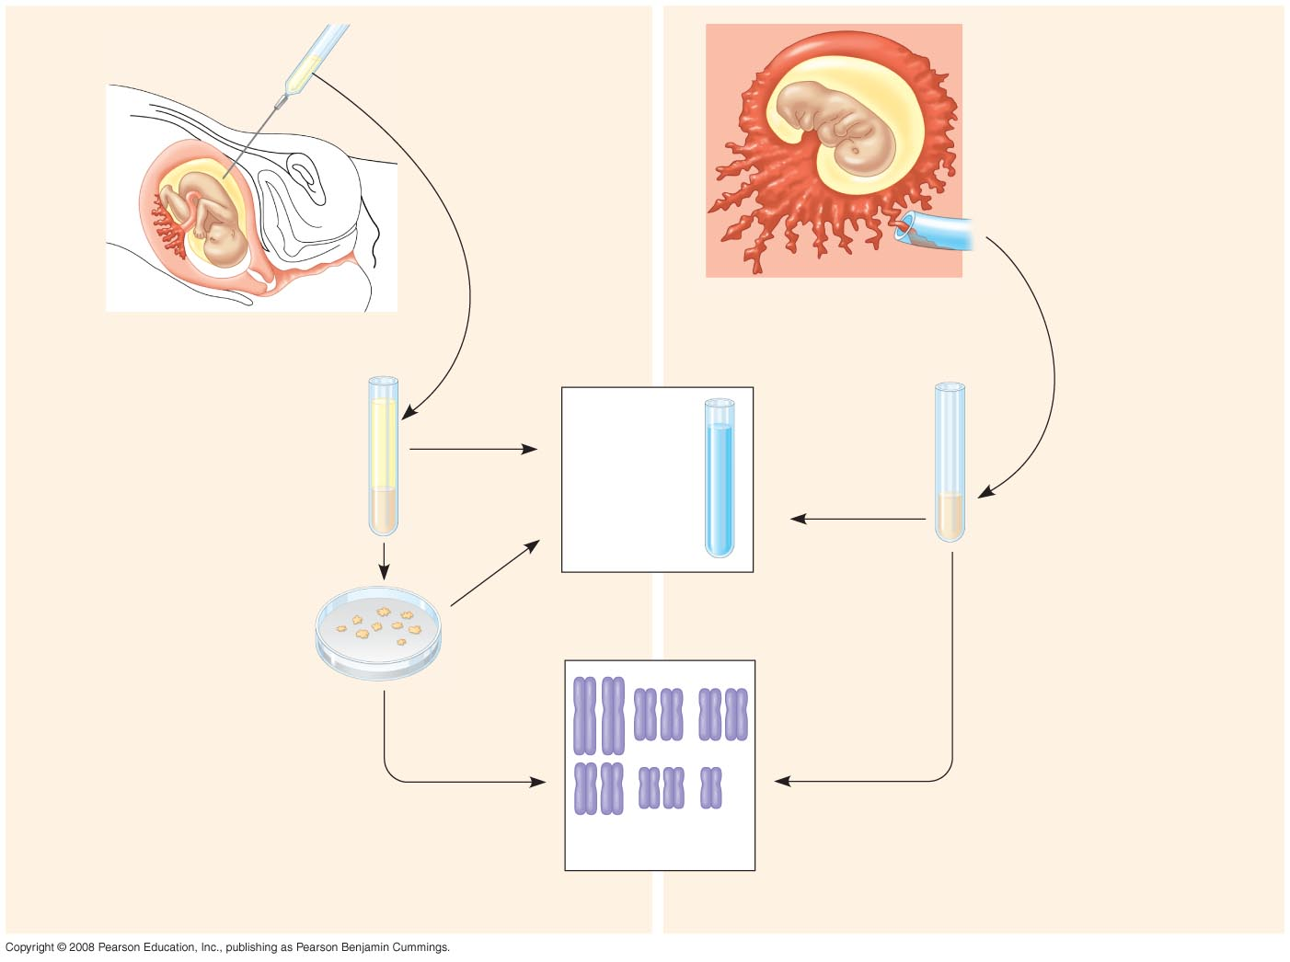
Amniotic fluid
withdrawn
Fetus
Centrifugation
Fetus
Suction tube
inserted
through
cervix
Placenta
Placenta
Chorionic
villi
Uterus
Cervix
Fluid
Bio-
chemical
tests
Fetal
cells
Several
hours
Several
hours
Fetal
cells
Several
weeks
Several
weeks
Several
hours
Karyotyping
(a) Amniocentesis
(b) Chorionic villus sampling (CVS)

